Slide 1
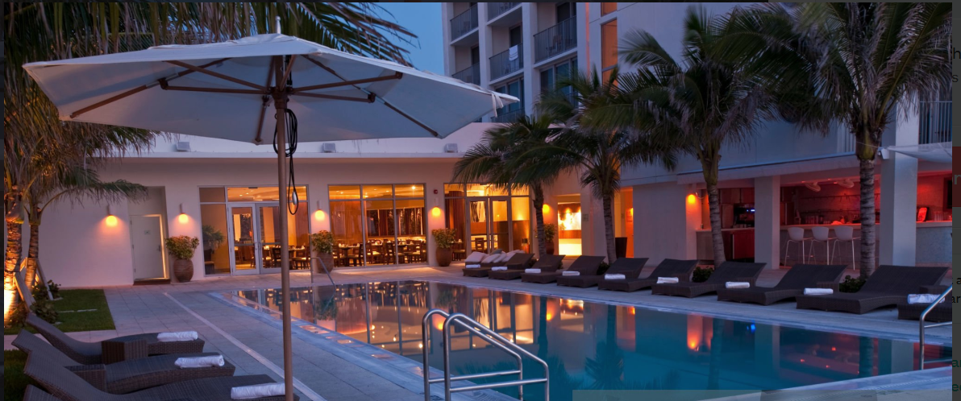

ATLIQ GRANDS
HOSPITALITY
REVENUE ANALYTICS

Slide 2
Agenda
Company Overview
Problem Statement
Live Dashboard
Insights
Recommendations

Slide 3

Company Overview
AtliQ Grands is a premium hotel chain with 20+ years in the hospitality industry.
They operate multiple five-star properties across major Indian cities, serving both business and leisure travelers.

Slide 4
Presence in Major Cities
Delhi
Mumbai
Bangalore
Hyderabad

Slide 5
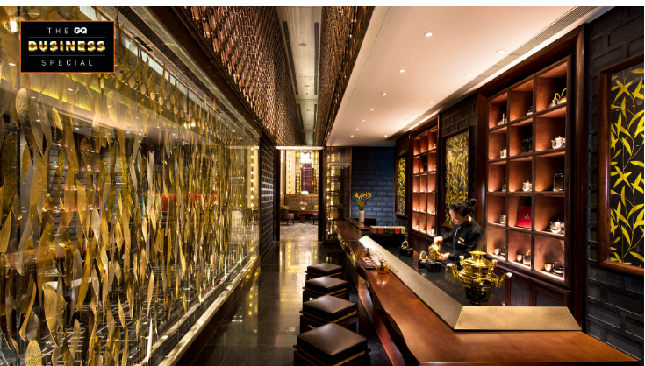
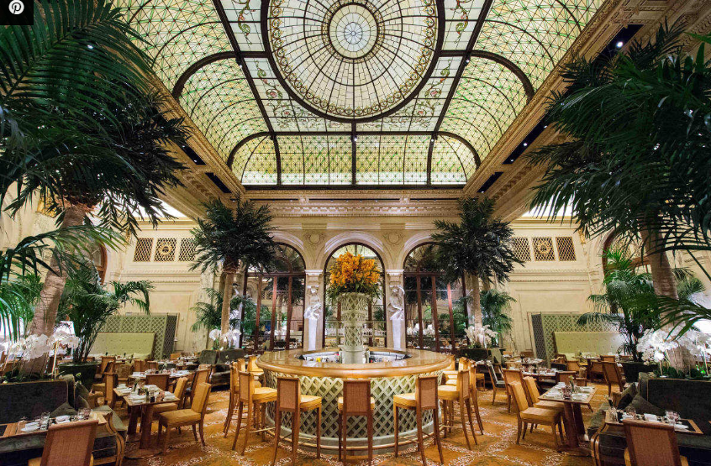
Hotel Categories
Business Hotel
AtliQ Seasons
AtliQ Bay
AtliQ Exotia
Luxurious Hotel
AtliQ Palace

Slide 6
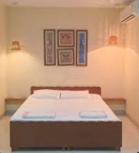
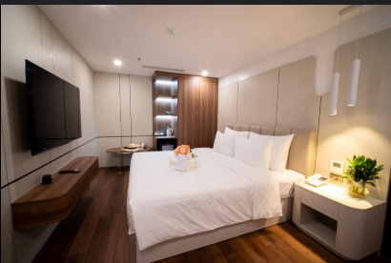
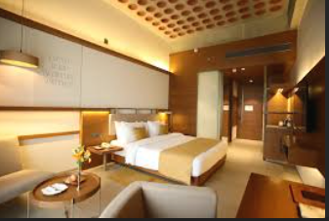
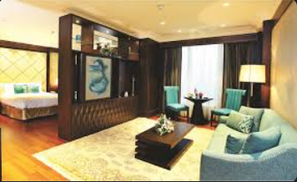
Room Types
Standard
Elite
Premium
Presidential

Slide 7
Problem Statement
AtliQ Grands is losing market share and revenue due to strong competition and poor decision-making.
To overcome this, the company plans to use Business and Data Intelligence to make better decisions and improve performance.

Slide 8
Live Dashboard

Slide 9
Insights
Business travelers drive most of the revenue, showing a strong dependency on this segment.
Mumbai earns the highest revenue, while Delhi has high occupancy but low revenue—pointing to pricing issues.
Customer ratings vary a lot across properties, showing inconsistency in service quality.
Weekends perform better than weekdays in revenue, occupancy, and room rates.
Direct and offline bookings give better profits than third-party travel platforms.
Some cities have high occupancy but still low revenue, suggesting room pricing needs adjustment.
The average customer rating is 3.62, indicating scope to improve guest experience.
Some booking platforms and properties are lowering the overall realization rate, affecting profits.

Slide 10
Recommendations
Adjust pricing in cities like Delhi to match high occupancy with better revenue.
Improve service quality across all hotels through staff training and regular audits.
Boost direct bookings with loyalty programs and special offers to increase profits.
Use weekend demand to promote special packages and festive deals.
Run local marketing in cities like Bangalore and Hyderabad to increase bookings.
Upsell premium rooms and enhance luxury experiences to grow revenue.
Collect and act on guest feedback regularly to improve satisfaction.
Add new revenue sources like events, conferences, and influencer tie-ups.

Slide 11
Thank you

